Slide 1

Hydra overview
Hydra – Used by non-developers to generate enterprise level apps for both web and mobile

Slide 2
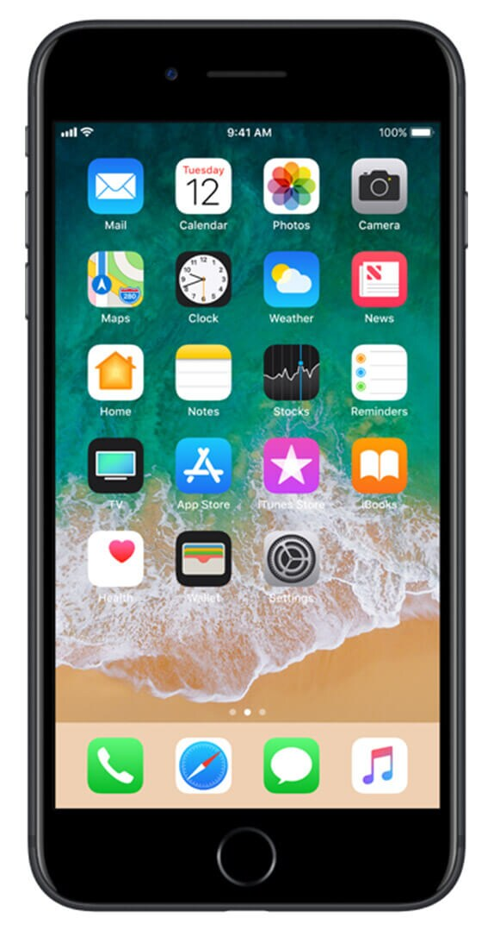
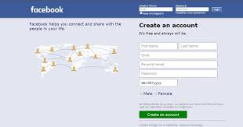
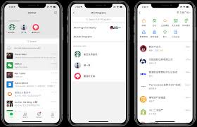
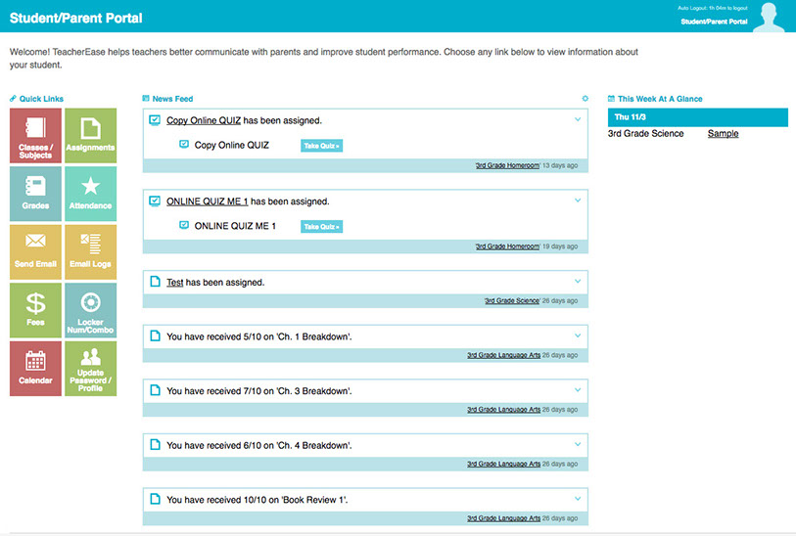
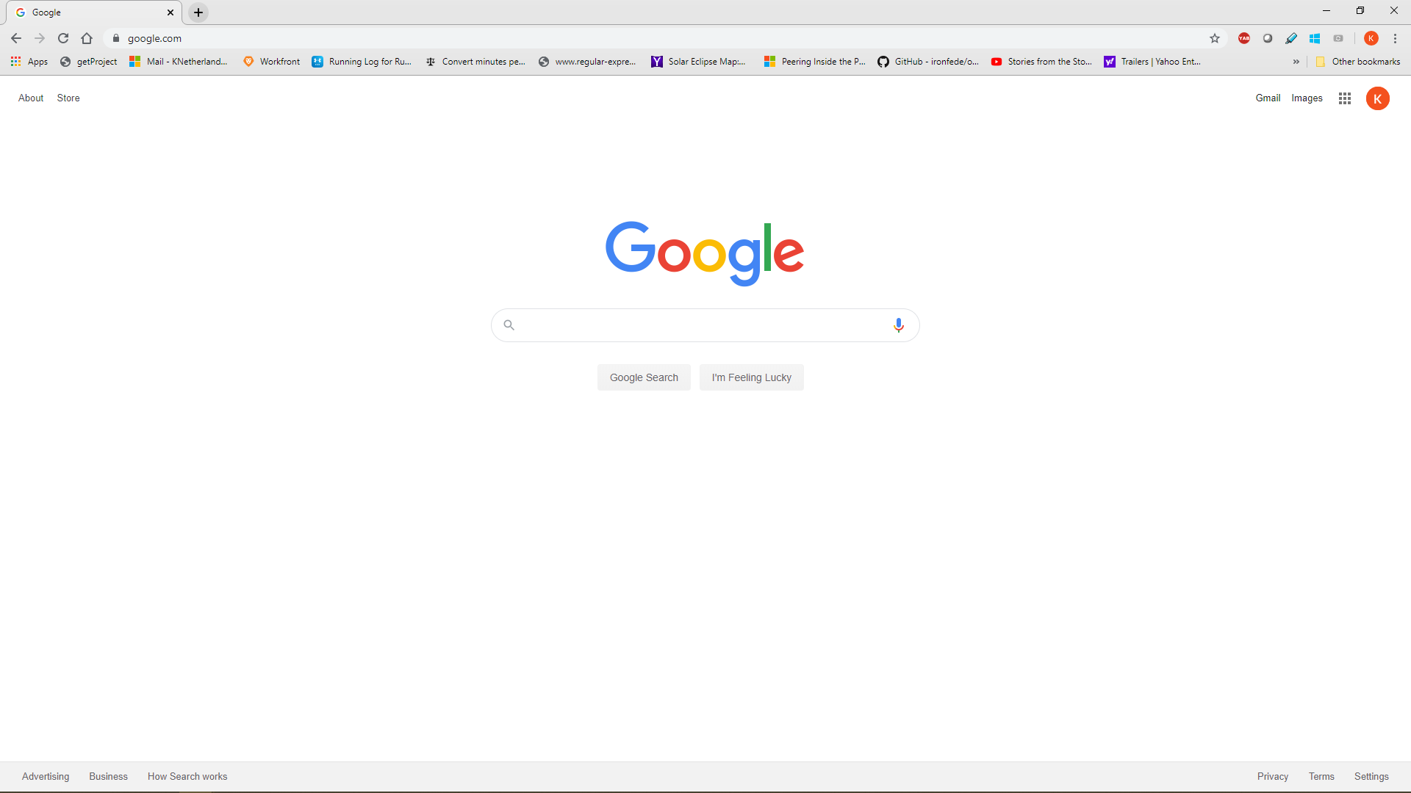
Applications

Slide 3
Application idea -
Product Owner – “I want a weekly chore application”

Slide 4
Application – Weekly chore spreadsheet
Scrum Master – “Let’s schedule some time to get the details of what you want” (Grooming)

Slide 5
Application – Weekly chore spreadsheet – Grooming event
User Story:
“As the head of the household, I want to track chores, who does each chore, and the planned time for when he/she will do it”
Scrum Master – “Developer, how difficult is this?”
Developer – “On a scale of 1-5, that is a 3 (story points)”
Scrum Master – “Developer, let’s schedule time to plan”

Slide 6
Application – Weekly chore spreadsheet – planning event
Scrum Master – “What tasks for this can you get done in 2 weeks?”
Developer
Tasks:
Create rows and columns – 3 days
Create task list – 2 days
Create done status visual – 2 days
Graphics – 3 day

Slide 7
Application General architecture - simplified

Slide 8
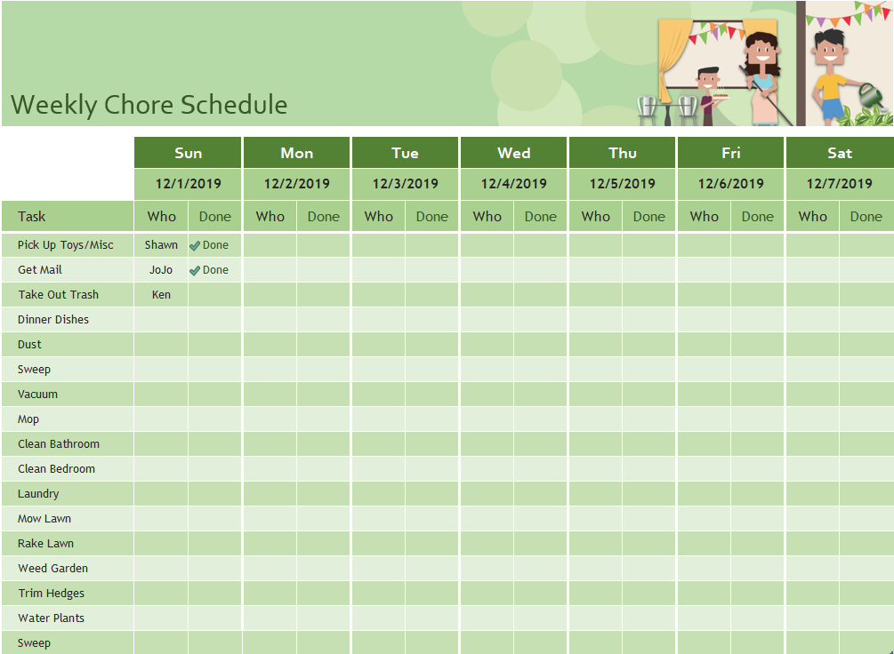
Application General architecture – Weekly chore spreadsheet – review event

Slide 9
Application – Weekly chore spreadsheet – grooming
Product Owner – “Nice spreadsheet. I want more”
User Story:
“As the head of the household, I want tabs for each weeks tasks”

Slide 10
Application – Weekly chore spreadsheet – planning event
Developer – “I need to start saving versions of the spreadsheet in a source code repository so I can track the changes”
Tasks:
Set up source code repository – 3 days

Slide 11
Application General architecture – Weekly chore spreadsheet
https://github.com/CloudIDEaaS/root
Ken - Original Version
Check in on 12/7/2019
Not part of the application but a tool used for development
Ken – Added “Create Week” button
Currently checked out

Slide 12
Application – Weekly chore spreadsheet – grooming event
Product Owner
User Stories:
“As members of the family, I want to be able to enter information into the spreadsheet, sometimes at the same time.”
“As head of the household, I should have ability to see the updates”

Slide 13
Application – Weekly chore spreadsheet – planning event
Developer – “I need to create a database to manage the concurrent changes”
Tasks:
Set up database – 5 days

Slide 14
Application General architecture – Weekly chore spreadsheet

Slide 15
Application – Weekly chore spreadsheet – grooming event
Product Owner
User Stories:
“As head of the household, I want to be able to access the spreadsheet anywhere, at any time, from my laptop or my phone”

Slide 16
Application – Weekly chore spreadsheet – planning event
Developer – “I need to create a service that can retrieve the spreadsheet from anywhere, with the ability to create, read, update, and delete data at any time”
Tasks:
Set up service layer – 10 days

Slide 17
Application General architecture – Weekly chore spreadsheet
Service Methods
Get Spreadsheet
Create Chore
Read Chores
Update Chore
Delete Chore
Create Week
Read Weeks
Update Week
Delete Week

Slide 18

Hydra - Weekly chore application
Thoughts and Ideas

Slide 19
Hydra - Architecture

Slide 20
Glossary
DevOps | Combination of development and operations. Development is about creating and enhancing products. Operations is about delivery of those products and their enhancements to the various environments: Test - for testers Production - for end users DevOps centers around the combined cycle through automation, continuous delivery, and best practices.
Target Application | The application generated by Hydra
SQL | Structured query language. It’s a scripting language for databases
Azure | A a cloud computing service created by Microsoft for building, testing, deploying, and managing applications and services through Microsoft-managed data centers
Cloud computing | Cloud computing is the on-demand availability of computer system resources, especially data storage and computing power, without direct active management by the user
Github | Provides hosting for software development version control using Git, a distributed version-control system for tracking changes in source code during software development
npm | npm (originally short for Node Package Manager) is a package manager for the JavaScript programming language. Npm is the application source for the HydrCli
HydraCli | Hydra command line interface. HydraCli is written in JavaScript for the Node runtime environment. A command-line interface (CLI) is a means of interacting with a computer program where the user (or client) issues commands to the program in the form of successive lines of text (command lines). The HydraCli allows application generation to happen via command line.
Javascript | programming language for the web and for mobile
Hydra Business Modeler | A web based application which allows a business professional to create a model of the business and use that information to generate an application via the Hydra system.
Source Code | Text based files that contain the programming code to create an application
Source Code Repository | The main purpose of a repository is to store a set of files, as well as the history of changes made to those files (version control). Version control is the ability to manage the change and configuration of an application. Versioning is a priceless process, especially when you have multiple developers working on a single application, because it allows them to easily share files. Without version control, developers will eventually step on each other’s toes and overwrite code changes that someone else may have completed without even realizing it. Using these systems allows you to check files out for modifications, then, during check-in, if the files have been changed by another user, you will be alerted and allowed to merge them.

